Slide 1
Homework (1)
Create the following Web page using external CSS styles. Buttons should consist of PNG images with text over them.

Slide 2
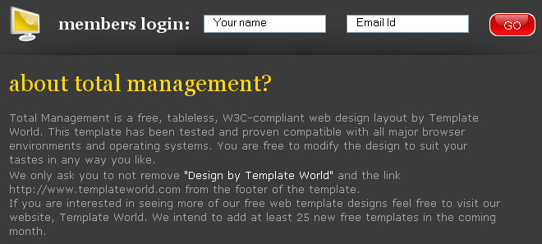
Homework (2)
Create the following Web page using HTML with external CSS file. Note that the images should be PNG with transparent background.

